Slide 1
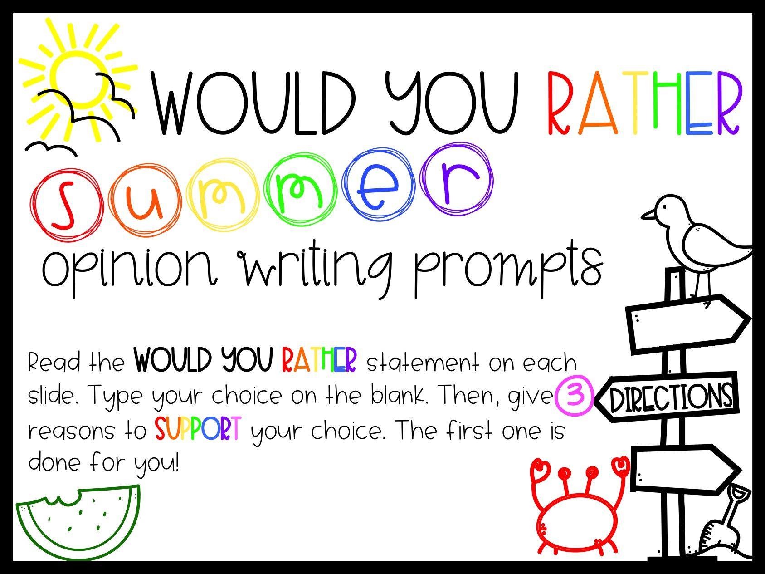

Slide 2
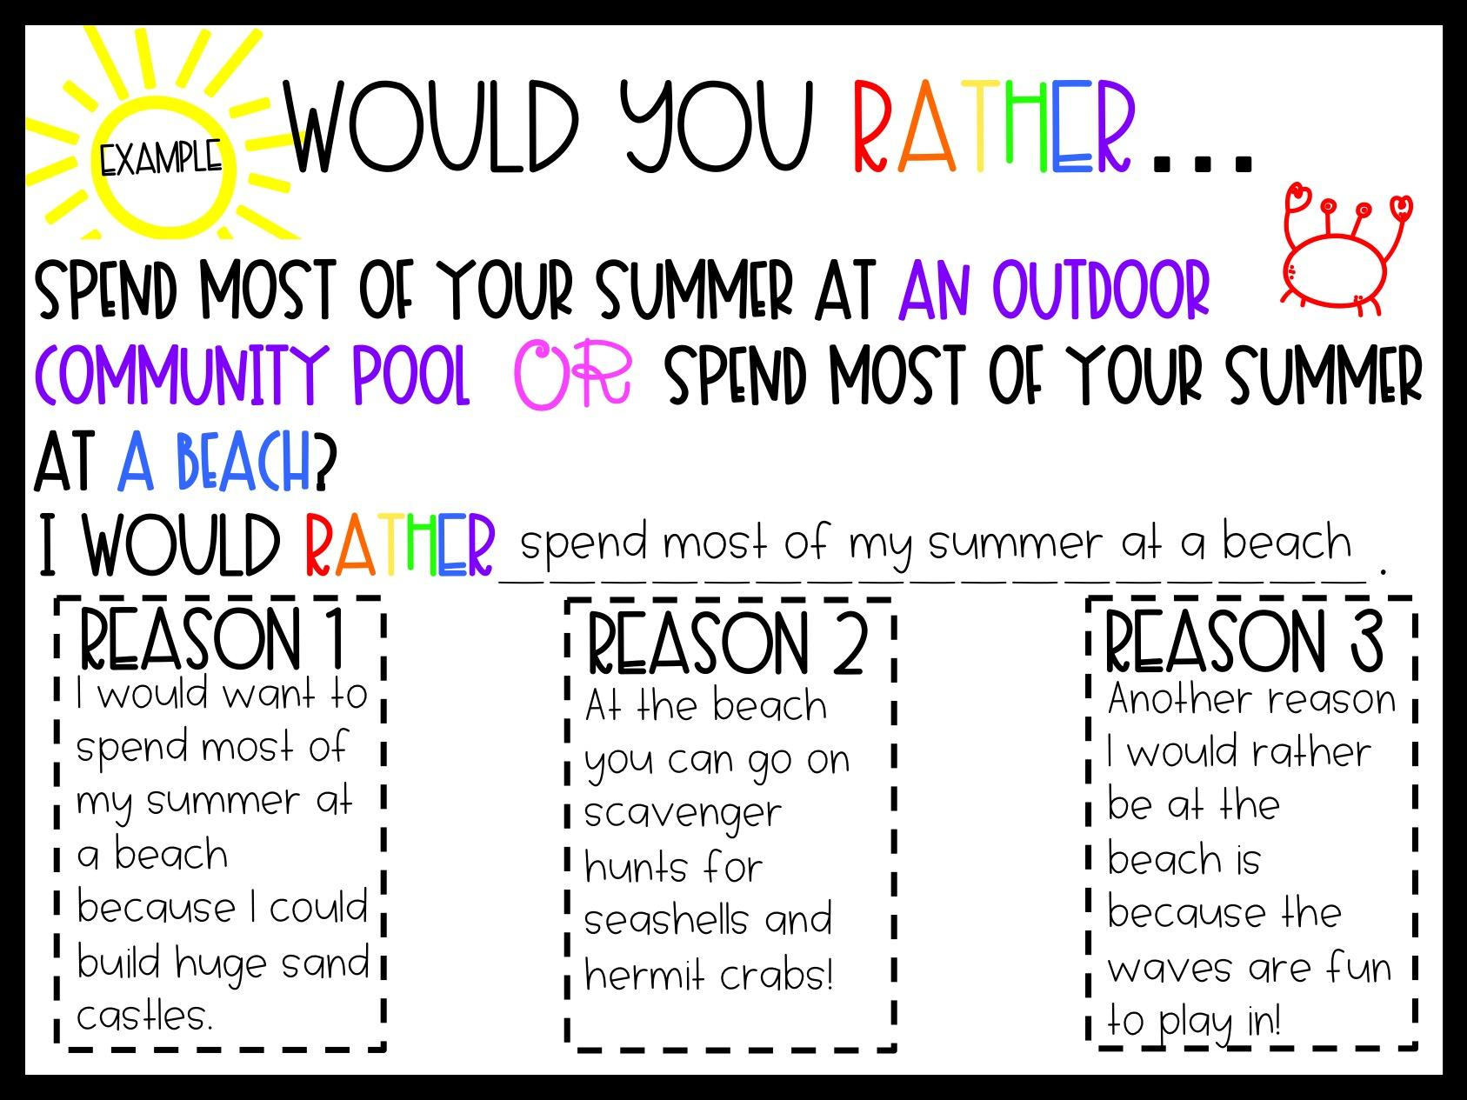

Slide 3
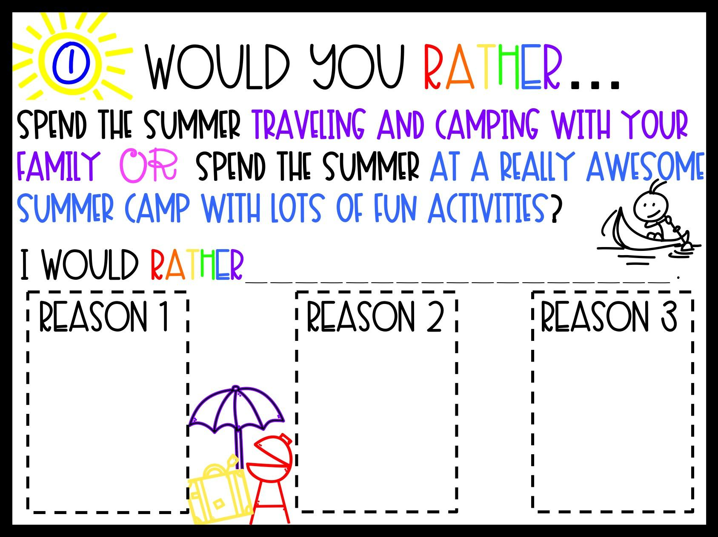
travel and camp with with my family.
I would rather travel and camp with my family because I could eat Marshmallows.
Traveling and Camping you can ride bikes sleep in tents and sit by the fire.
Another reason I would rather go camping is because

Slide 4
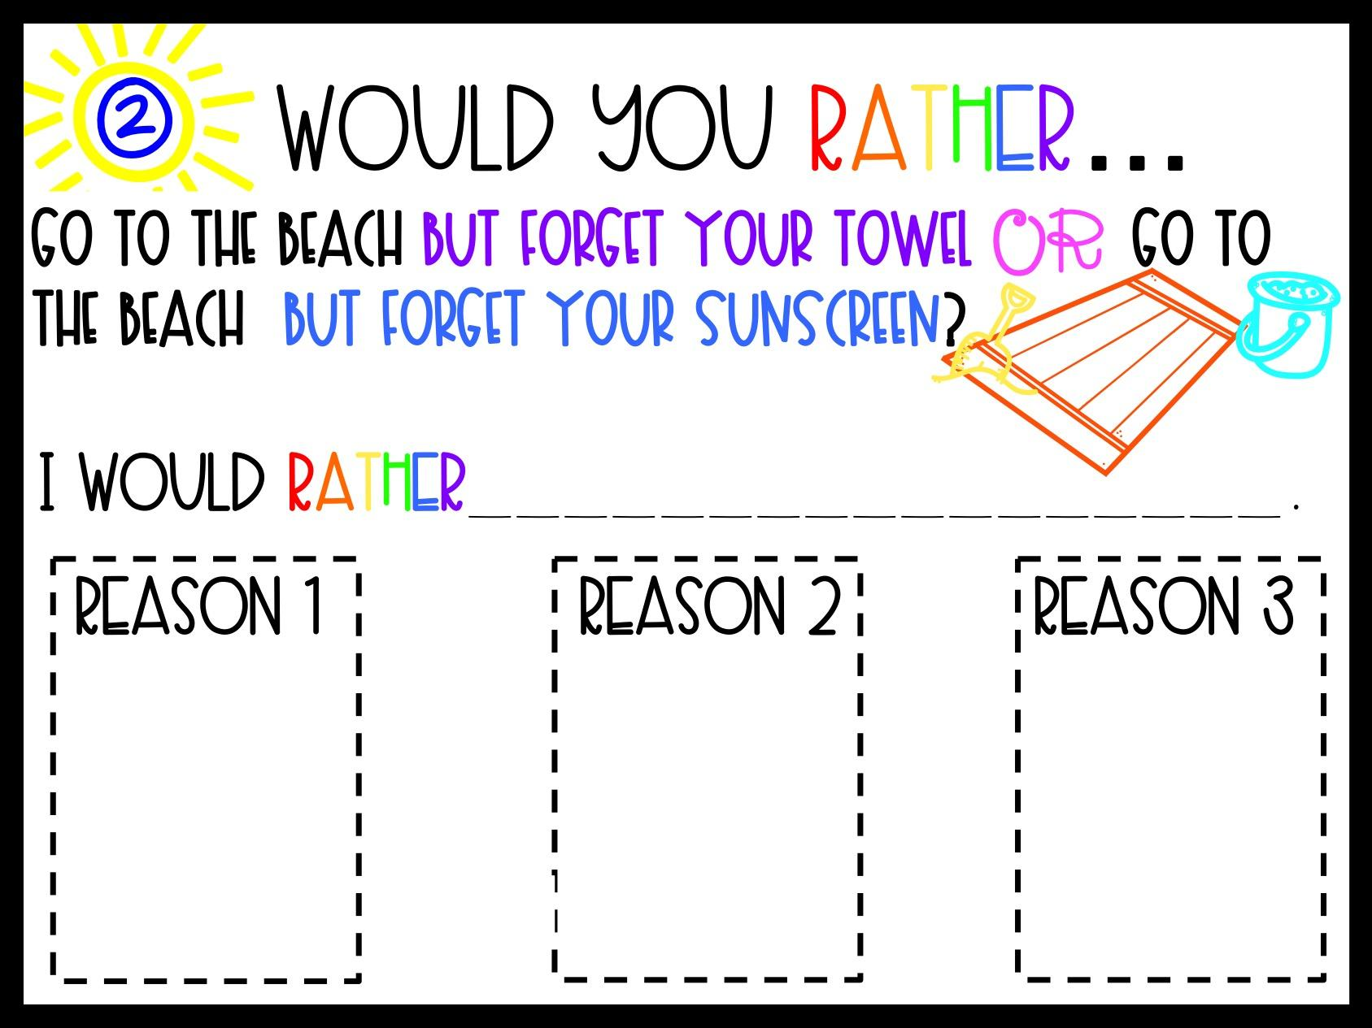
go to the beach but forget my own towel.
I would rather go to the beach and forget my own towel because I could just use a towel from the pool.

Slide 5
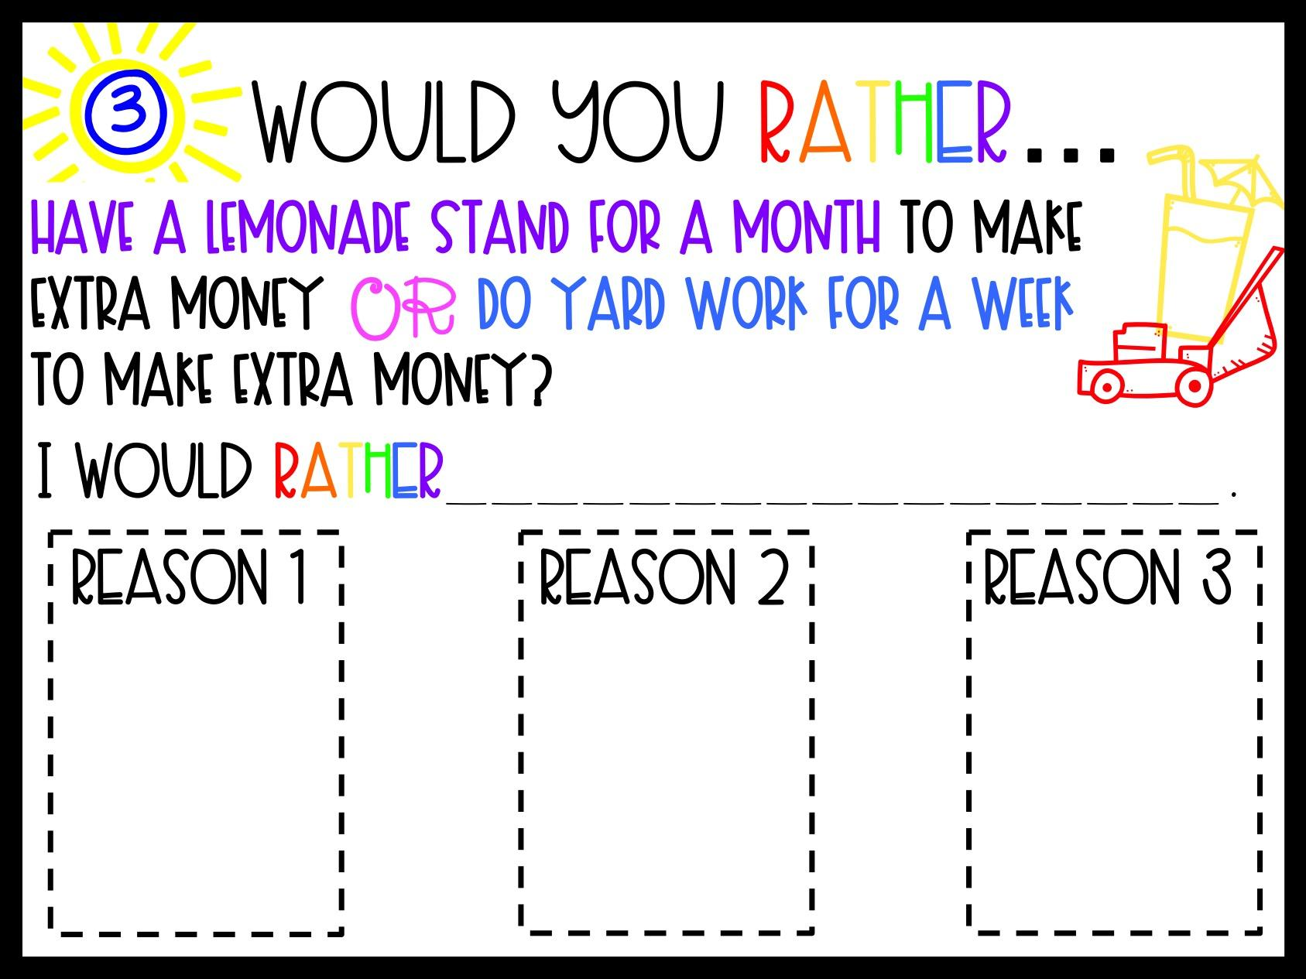

Slide 6
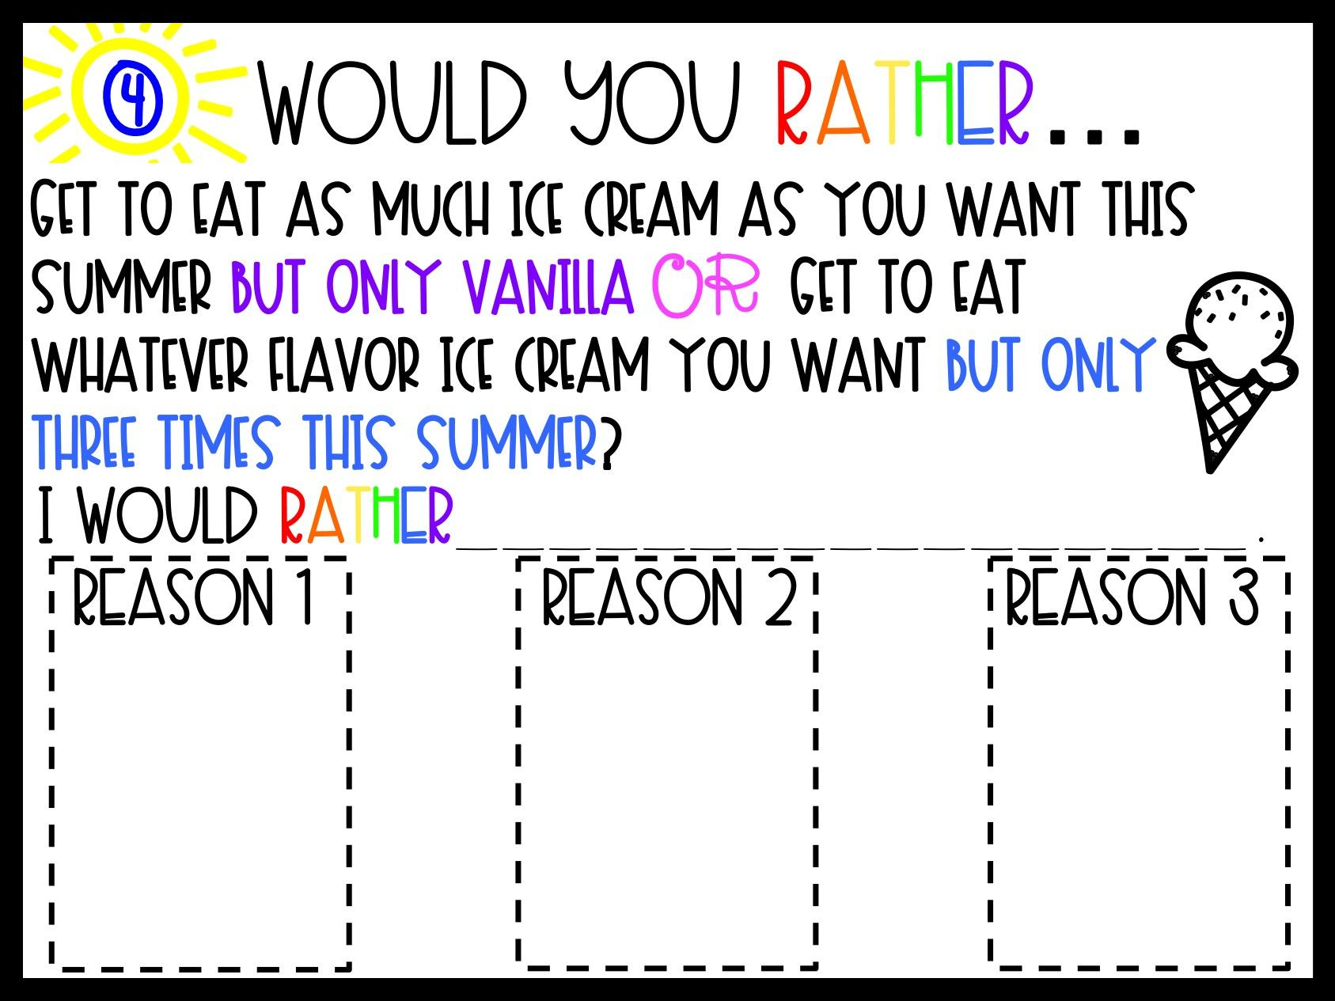

Slide 7
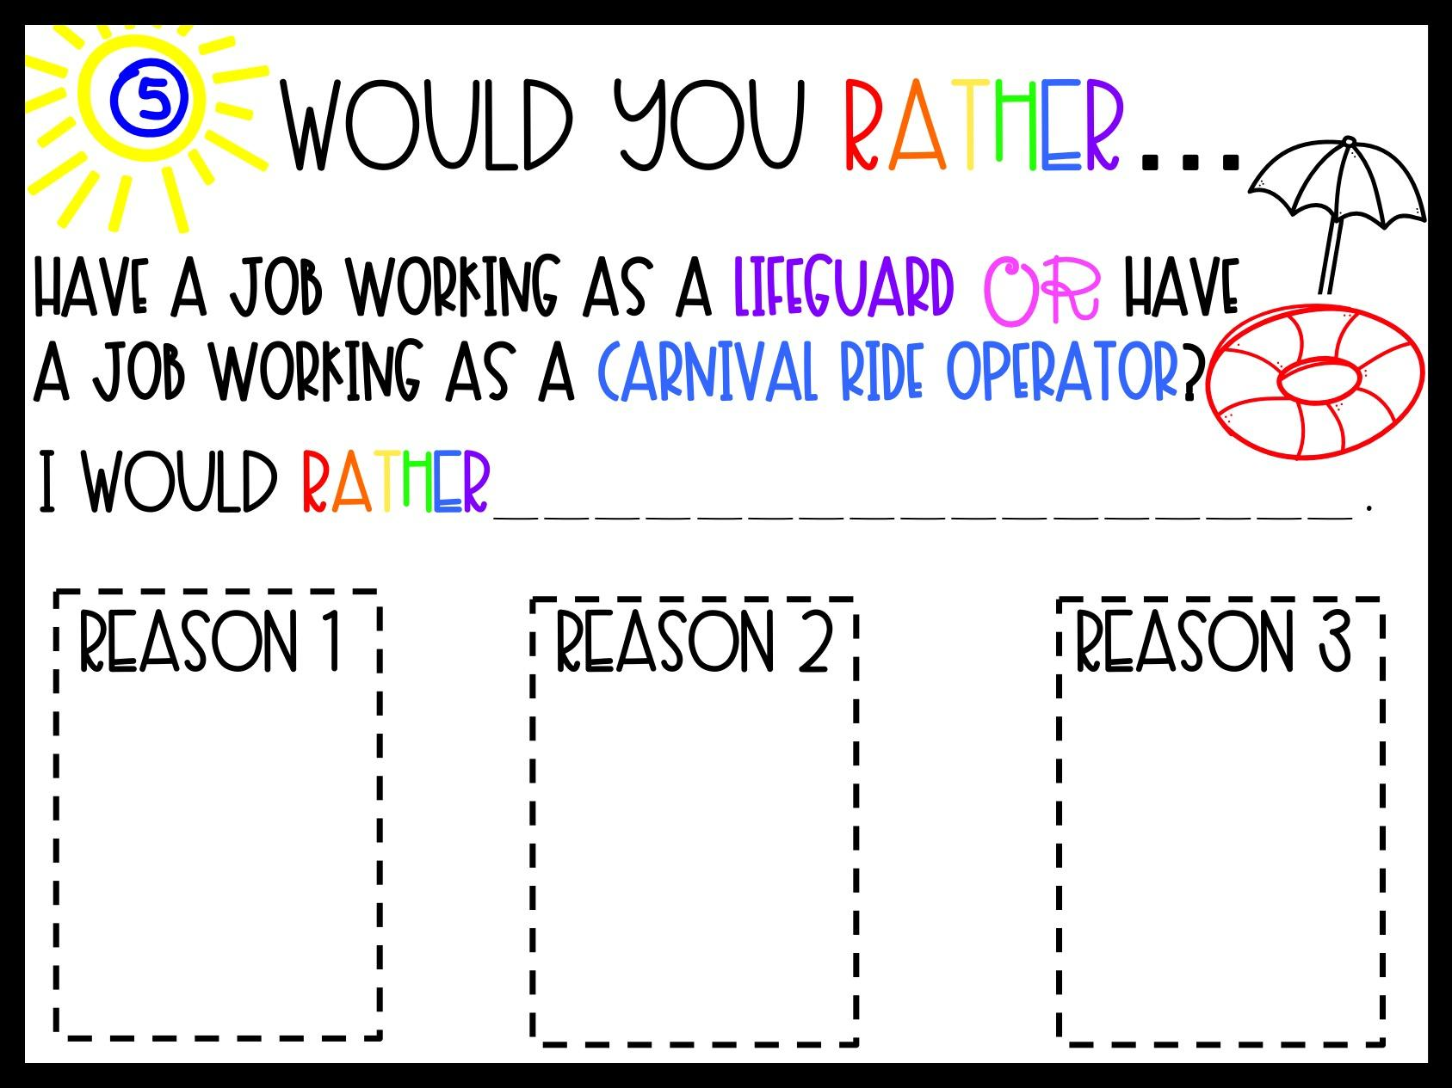

Slide 8
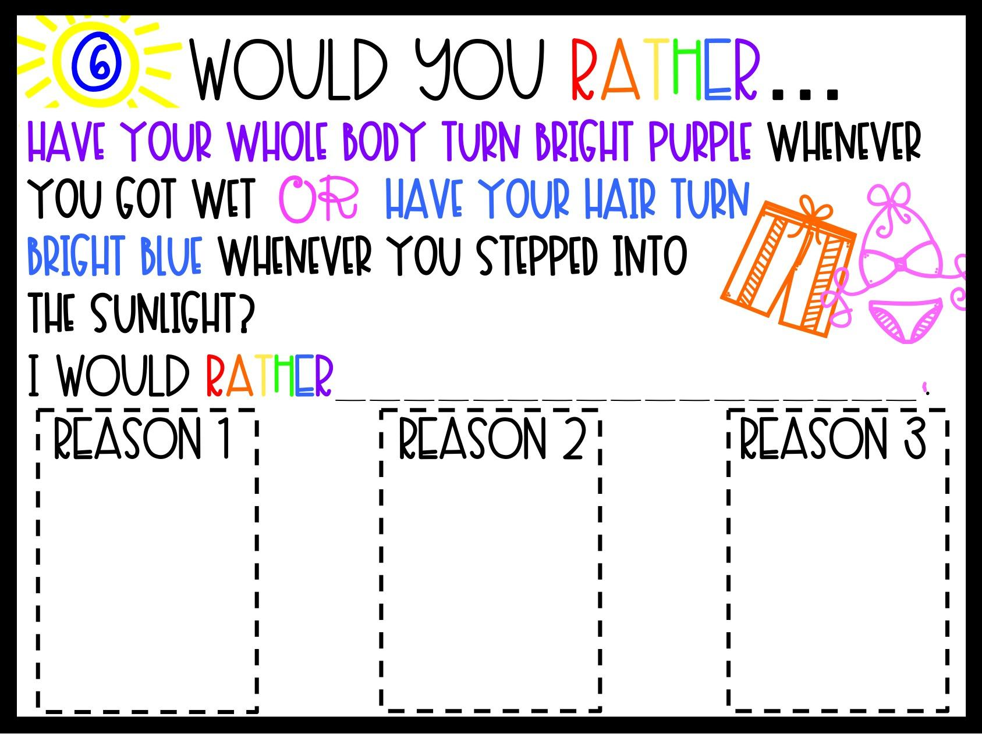

Slide 9
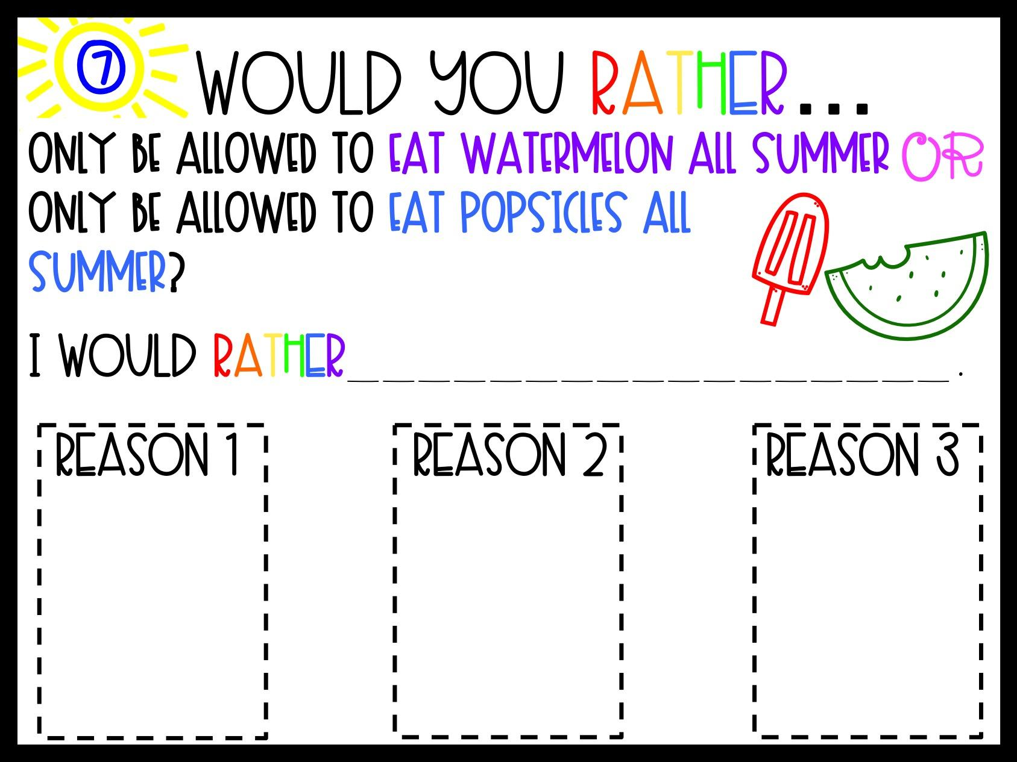

Slide 10
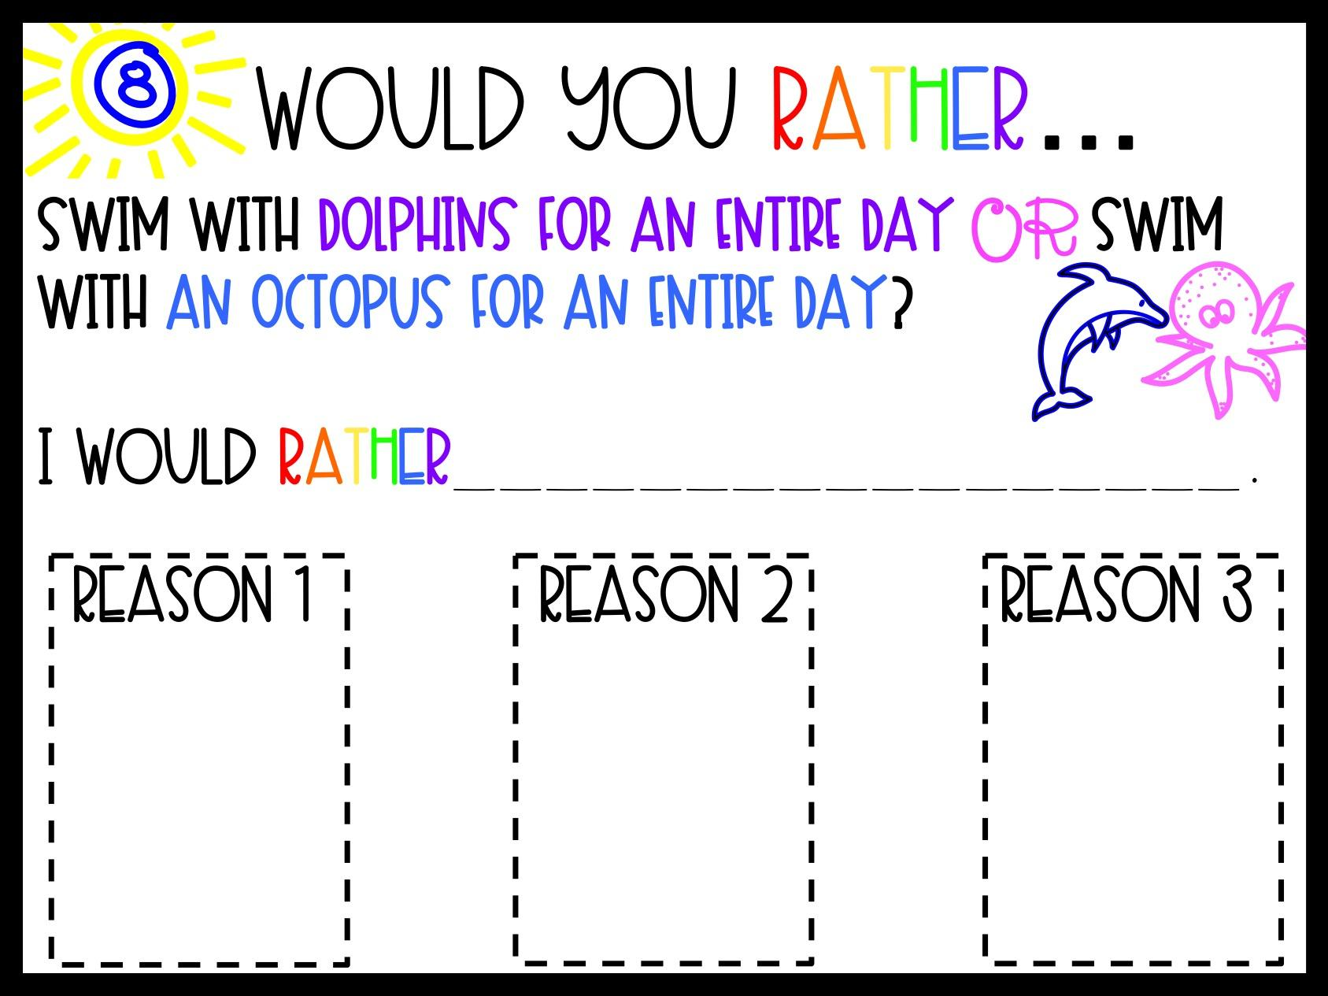

Slide 11
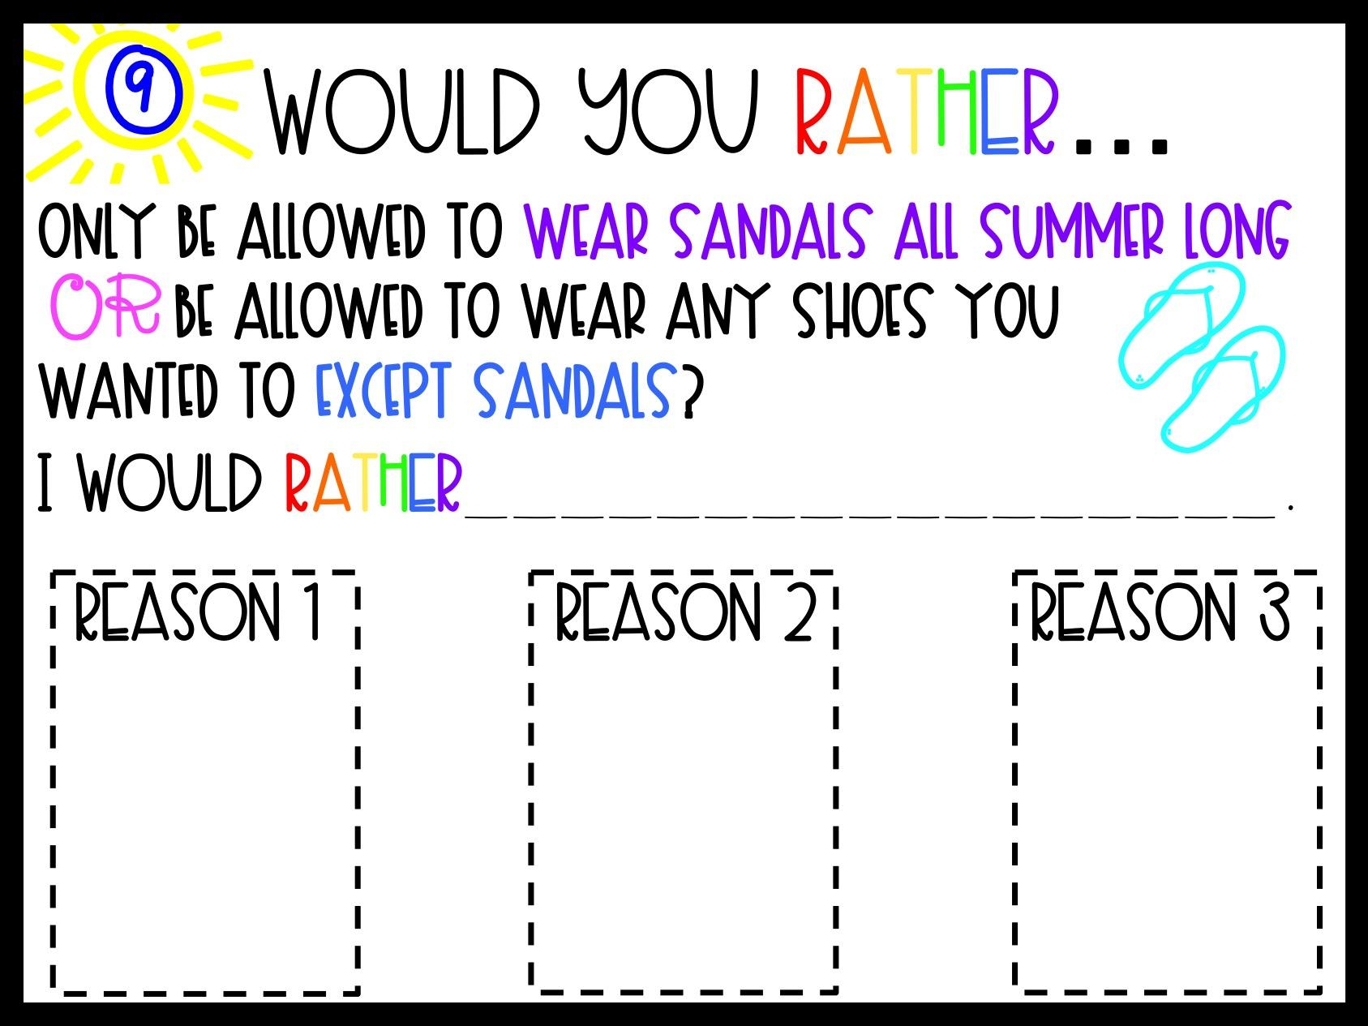

Slide 12
